Slide 1

Forecasting Industrial Production
using Temperature and GDP
By Ghamiah Aseri
Professor Don Dalton

Slide 2
Table of content
Introduction
Data description
Approach
Preprocessing
Visualization
VAR Model
Model building
forecasting
Result and performance
Conclusion
Future work
References

Slide 3
1. Introduction
The aim of this project is to develop a predictive model to forecast the industrial production in future of the US.
The industrial production includes gas and electricity.
We know that the industrial production depends on the weather condition, and the financial condition of any place.
For supportive variable, I have chosen the temperature and the GDP of the country.
I have used Vector Auto Regression(VAR) model to do the forecast.

Slide 4
2. Data Description
I have used 3 datasets. These datasets have monthly frequency and different range.
Industrial Production(1939 to 2021)
Average Temperature (1895 to 2021)
Normalized GDP of USA (1960 to 2021)

Slide 5

3. Method
My approach to the solution of this problem is:
Merging the Datasets
Preprocessing
Checking for stationarity
Transforming the data to remove stationarity
Finding model parameters
Building the model with found parameters
Forecasting
Inverse Transform of the data
Visualizing the results
Various performance measure

Slide 6
3.1 Merging the Datasets
I had three individual Datasets; Industrial production, temperature and the GDP. I merged them together.
The Merged dataset has range from 1960 to 2021 because it is the time which is common in all three datasets.

Slide 7
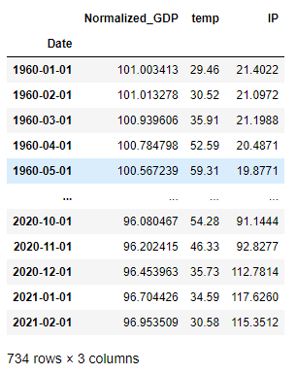
Merging the Datasets
This is how merged datasets look like

Slide 8
3.2 Preprocessing
Checking the stationarity of the data using Augmented dickey fuller test.
Found that in the Industrial production series is non-stationary
Using log transform to remove the exponential variance from the data to make it stationary. Then, checked the stationarity again and this time it was not stationary.

Slide 9
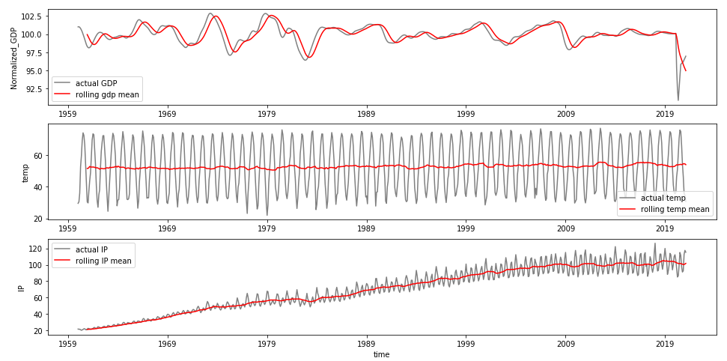
3.3 Visualization
Here is the plot of all the three series along with it’s rolling mean (12 months)

Slide 10
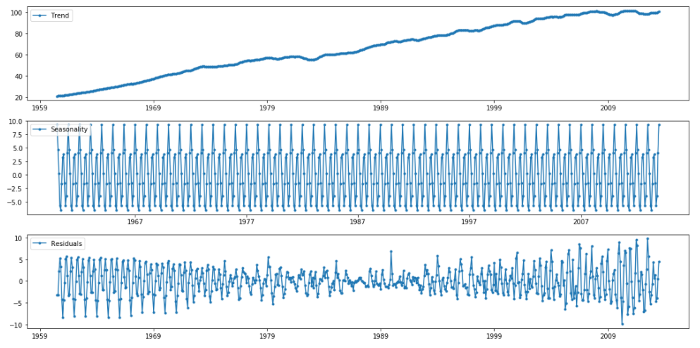
Visualization
Seasonal decomposition of the Industrial production series. We can see the trend seasonality and residual component of the industrial production series.

Slide 11
3.4 Vector Auto Regressor (VAR) model
VAR is a statistical model that is used for time series modeling
Capture the relationship between multiple quantities as they change over time.
VAR models generalize the single-variable (univariate) autoregressive model by allowing for multivariate time series.
It does not only take the past data of the same series for prediction but also past and present data of some other variable(columns) as well.
Dependency on other variable makes it fit best and give better results compare to another model.

Slide 12
I iterated from 1 to 20 to select the lag parameter for the model and found that the model gives best performance on lag 17, but I choose the lag 13 to make balance between the complexity of the model and the accuracy. - Higher lag value will make more complex model. That will take more time to run
3.5 Finding the model parameters

Slide 13
3.6 Building the model with found parameters
Then, I used lag 13 to fit the model.

Slide 14
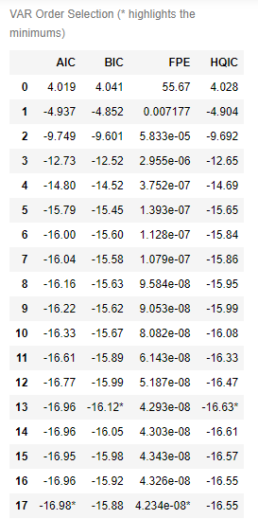

3.7 Getting the model parameter
VAR model is giving the lag value based on AIC and BIC value

Slide 15
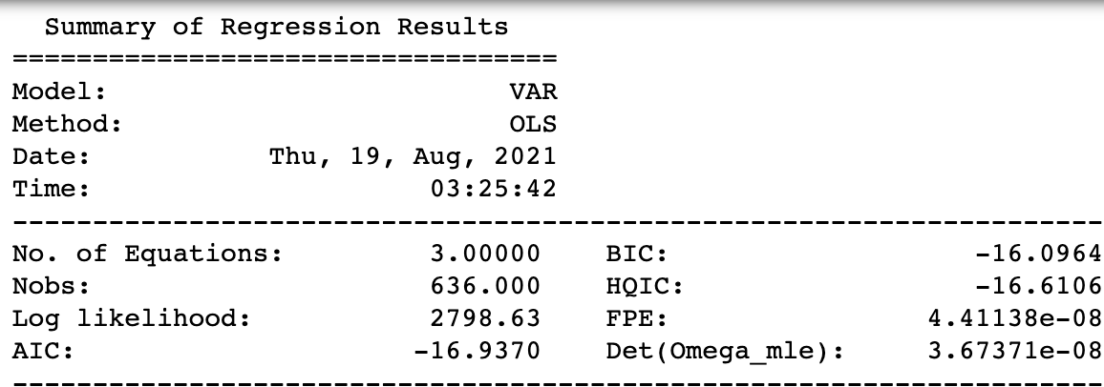
3.8 Summary of Regression Results

Slide 16
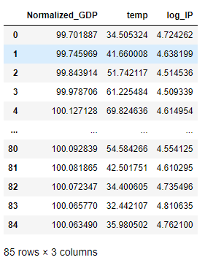
4. Forecasting
I forecasted the value from 2014 to 2021 for all three columns.
The values from to two columns are exact but the Industrial production series was transformed by log function before prediction.
Predicted data
Notes:
Results can be seen in the Code Notebook

Slide 17
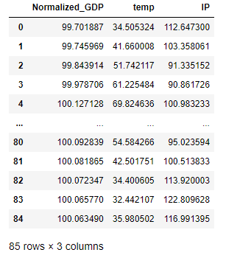
5. Inverse Transformation
Transformed data
The values from to two columns are exact but the Industrial production series was transformed by log function before prediction.
So, I will inverse transform the predicted series.
The inverse function of log is Exponential.
So, I will use exponential function to inverse transform it.
Note: Inverse transformation is done on the IP column only

Slide 18
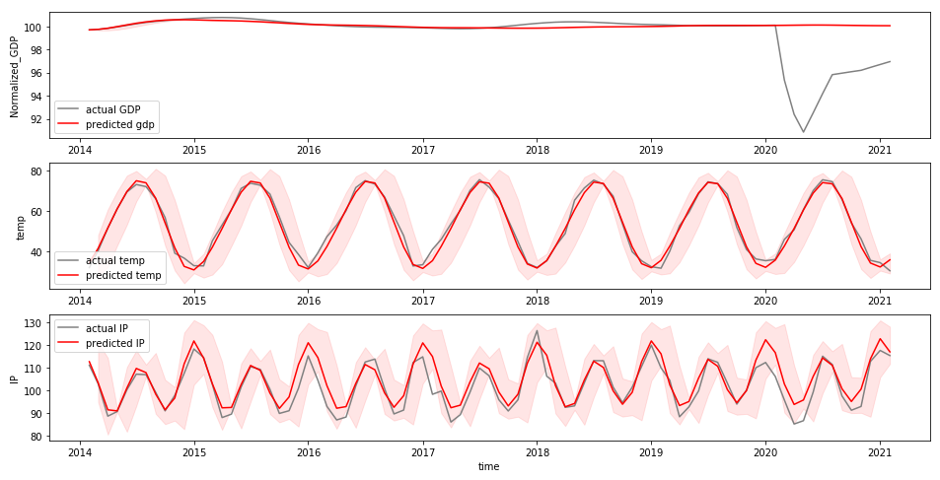
6. Visualizing the results
This is the results
Notes:
On the test data, the model is able to correctly predict Not only the short term trend of the industrial production, as we can see that the red line appears to be close to the actual values (Gray) and they both have a close run, and the test predictions are strongly able to identify the volatile variations in the industrial production from 2014 to 2021

Slide 19
7. Performance measure
The model performance well on the test data set as the results can be seen.
Here are some performance measure that verify the results
Performance matrix | Value
RMSE Error for feature(column) Normalized_GDP | 2.07033
RMSE Error for feature(column) temp | 2.27031
RMSE Error for feature(column) IP | 4.7036
R squred Error for feature(column) temp | 0.97711
R squred Error for feature(column) IP | 0.7682

Slide 20
8. Conclusion
The model performs well on the testing data.
Most of the predicted values on the training data are very close to the actual values.
These values are really small considering the range of values.
The R squared error is good as well as they are very close to 1

Slide 21
9. Future work
In the future with given more time and resources one can make a more accurate model.
there is are chances to increase the accuracy of the model.
Neural networks for this task can be used as well, Such as RNN, LSTM and GRU for forecasting

Slide 22
References
https://www.statsmodels.org/dev/vector_ar.html
https://fred.stlouisfed.org/series/USALORSGPNOSTSAM
https://www.ncdc.noaa.gov/cag/national/time-series/110/tavg/all/6/1895-2021?base_prd=true&begbaseyear=1901&endbaseyear=2000
https://fred.stlouisfed.org/series/IPG2211A2N
https://www.statsmodels.org/stable/generated/statsmodels.tsa.vector_ar.var_model.VAR.html
https://www.edureka.co/community/72357/what-is-the-inverse-operation-of-np-log-and-np-diff
-https://otexts.com/fpp2/accuracy.html

